Slide 1
Monitoring and Predicting Mental Health using Morphological and Emotion Analysis of Twitter Data
Course Teacher:
Supervisor:
Dr. Md. Saddam Hossain Mukta
Assistant Professor, Dept. Of CSE,
United International University
MD. Adnanul Islam
Lecturer, Dept. Of CSE,
United International University

Slide 2

Members
Shah Nafiz Monjoor (011 163 096)
Omar Faruk (011 163 092)
K.M Mahmudul Haque (011 163 077)
Fatema Binte Iqbal (011 163 078)
Mahmuda Akter Mitu (011 163 069)

Slide 3
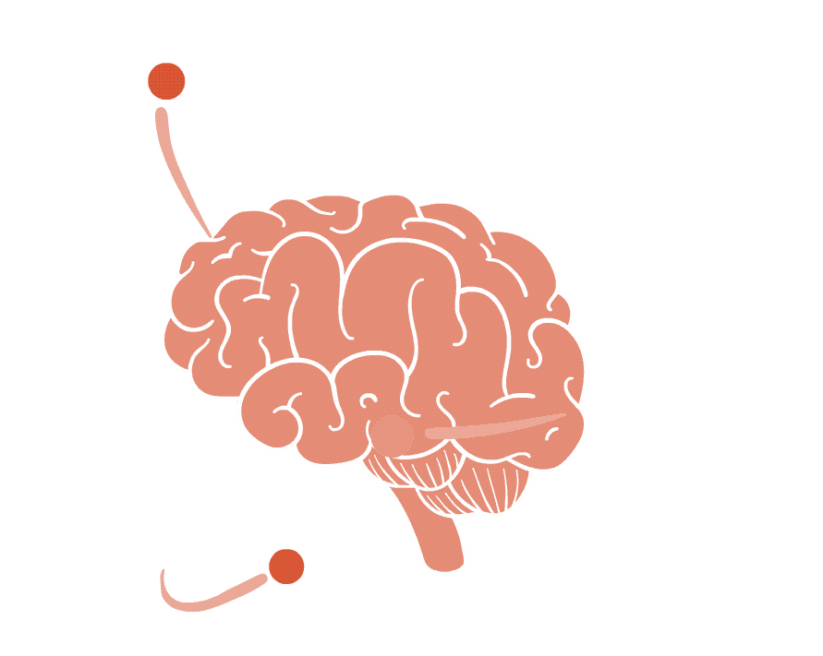
MOTIVATION
01
02
03
People suffering from mental health problems facing stigma, averting them from seeking help.
Existing Bengali users receiving inadequate mental health care.
Lack of knowledge about the details of therapists available in Bangladesh.

Slide 4
PROBLEMS
01
02
03
Increasing mental disorders leading to suicide cases.
Lack of cost effective applications to address mental health issues.
No efficient platform to analyze Bengali or Bengali-English
mix language.

Slide 5

OBJECTIVES
01
03
02
04
Language processing using
Compact Language Detector,
n-gram.
Detecting mental disorder using
LIWC, Neural Network, and
Cross Condition Comparisons.
Investigating different approaches to analyze language such as by using translator, Bengali, Banglish.
Preparing suitable datasets
for Bengali language
extracting from social media.

Slide 6
APPLICATIONS
01
02
03
People of all ages, especially adolescents.
Social media developers.
Hospitals, Doctor chambers, Educational
institute etc.

Slide 7




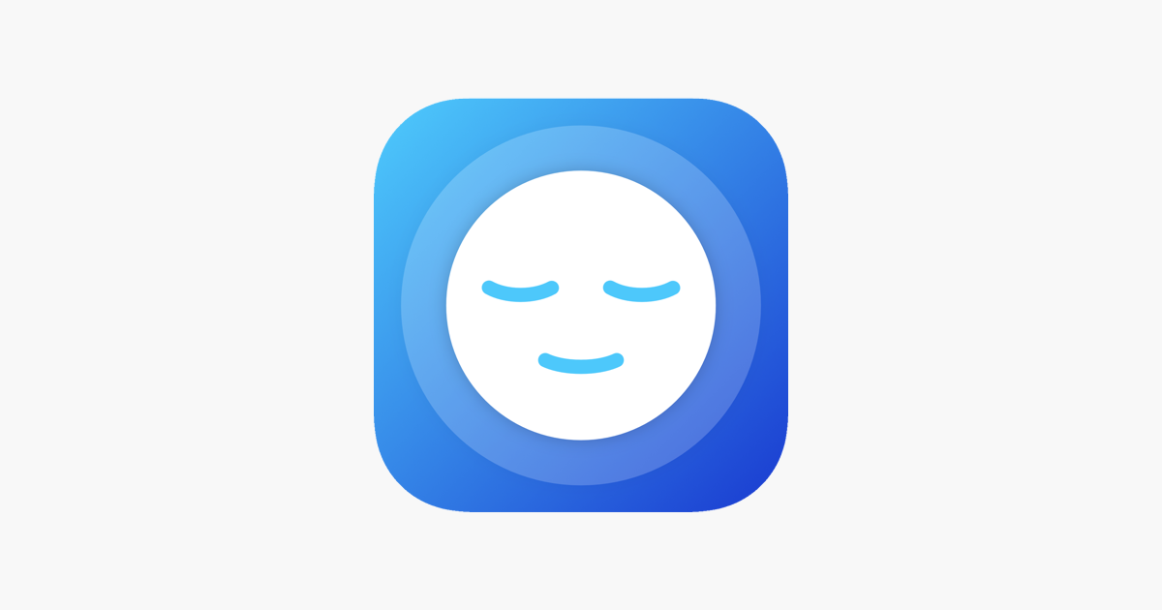
Benchmark Analysis
Youper
Sanvello
Youper utilizes Artificial Intelligence to assist users identify, track, and process their thoughts and feelings.
Sanvello uses principles of CBT(Cognitive Behavioral Therapy) to assist users with anxiety, depression, or stress.
Wysa
MindShift
Wysa is an artificially intelligent chat-bot which may coach users to better deal with daily stresses.
Mind-Shift is an app created to produce tools based on CBT and information to young adults experiencing anxiety.

Slide 8

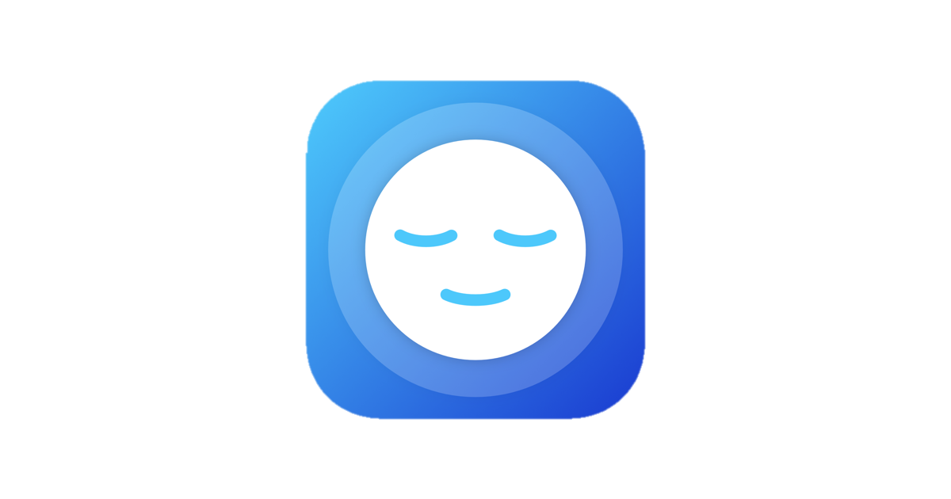


Comparison Table
Mobile Applications | Tracking Mood | Predicting result based on |  |  | Recommending Suggestions | Daily observation
 |  | Questionnaire |  | Twitter Tweets
Our App

Slide 9

Interactions
Welcome conversation
Login with twitter
View profile
Twitter data & Questionnaire
to identify mental condition
Predicting results
& recommending suggestions
Daily Basis Observation/
Monitoring

Slide 10
Methodology
Collecting users
tweets by
using Tweepy
Conducting
questionnaires
from users directly
Calculate score & matching with predefined score
Filtering &
data cleaning
Train machine
to analyze
mental health
Predicting Result/output
score
Recommend
suggestion & tracking mental health
in a loop
RNN
BERT
Store Results in a database (Firebase)

Slide 11
Datasets

Slide 12
Size of dataset:
Bangla: 17218
English: 1047575
Sources:
Kaggle
GitHub

Slide 13
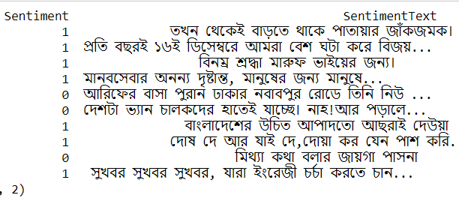
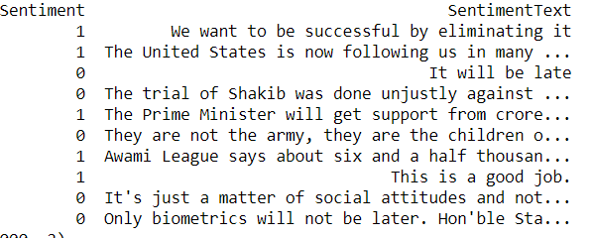
Figure: Sample of used dataset(English & Bangla)

Slide 14

Data Cleaning
Pandas
RegEx

Slide 15
Implementation and Results

Slide 16

Environment Setup
RNN Model:
Library:
Pandas
Tokenizer, pad sequences from Keras
TensorFlow library
Scikit-learn
Matplot library
TextBlob

Slide 17


Layers:
input layer
Embedding layer
Lstm (‘64’)
Globalmaxpooling1D
Dense layer (‘64’, ‘relu’)
Dropout (‘0.2’)
Dense layer (sigmoid)
Loss and optimizer:
BinaryCrossentropy
Adam (1e−4)

Slide 18
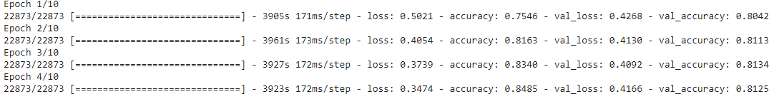
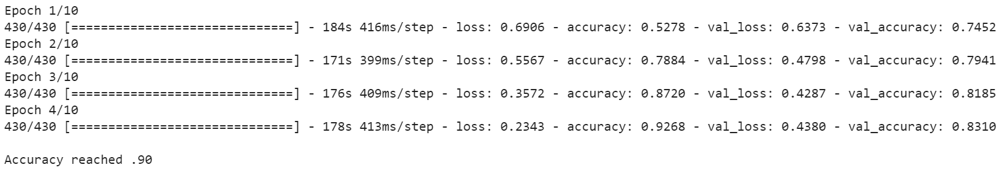
RNN
Figure: Model training history (English)
Figure: Model training history (Bangla)

Slide 19
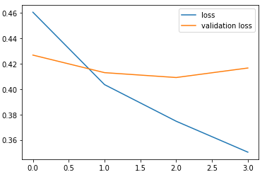
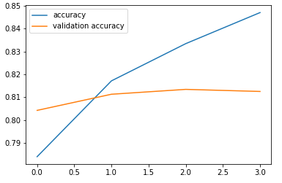
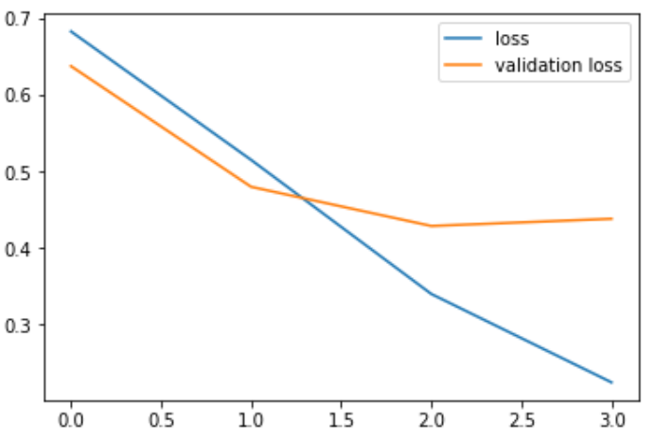
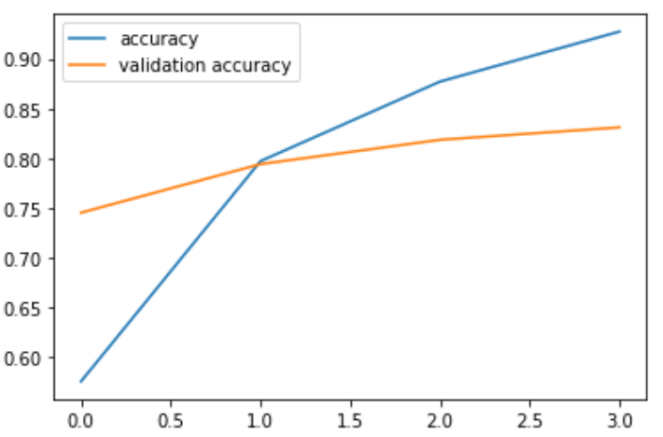
RNN
Figure: Loss vs Validation loss graph (English)
Figure: Accuracy vs Validation Accuracy graph (English)
Figure: Loss vs Validation loss graph (Bangla)
Figure: Accuracy vs Validation Accuracy graph (Bangla)

Slide 20
Result table test data set using RNN Model:
Train-Model | Test Dataset | Size | Accuracy
Bangla dataset | Bangla | 1000 | 0.829
 | English to Bangla | 1000 | 0.653
English dataset | English | 1000 | 0.845
 | Bangla to English | 1000 | 0.71

Slide 21
Environment Setup
BERT Model:
Library:
pandas, numpy, Scikit-learn, Matplot library
Lebel encoder
Official nlp bert
Tensorflow Hub
Bert tokenizer

Slide 22
BERT Model:
Layers:
input layer (inputwordids, inputmask and segmentids)
Dropout (‘0.1’)
Dense layer (softmax)
Loss and optimizer:
Categorical Crossentropy
nlp.optimization (1e−4)

Slide 23
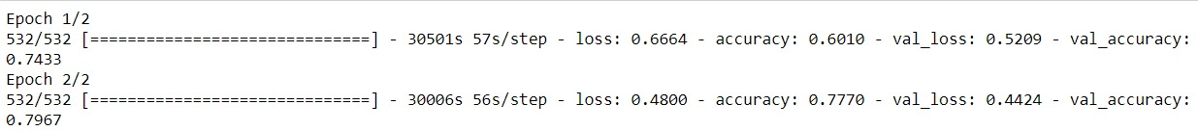
BERT
Figure: Model training history (Bangla)
Figure: Model training history (English)

Slide 24
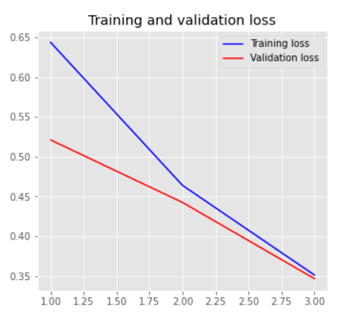
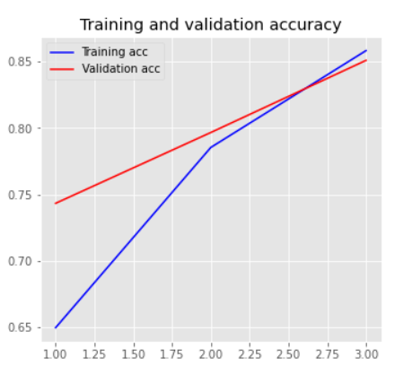
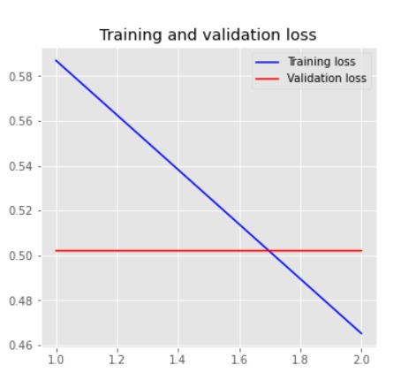
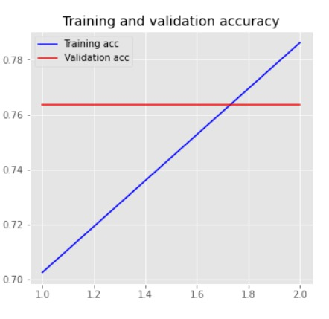
BERT
Figure: Loss vs Validation loss graph (Bangla)
Figure: Accuracy vs Validation Accuracy graph (Bangla)
Figure: Loss vs Validation loss graph (English)
Figure: Accuracy vs Validation Accuracy graph (English)

Slide 25
Result table of test data set using BERT Model:
Train-Model | Test Dataset | Size | Accuracy
Bangla dataset | Bangla | 1000 | 0.8140
 | English to Bangla | 1000 | 0.5480
English dataset | English | 1000 | 0.8290
 | Bangla to English | 1000 | 0.7010

Slide 26
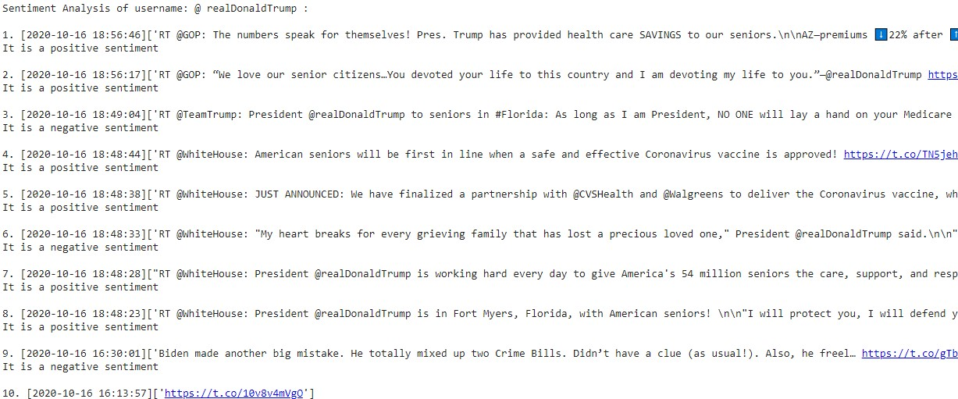
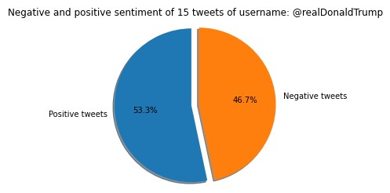
Figure: Sample of analyzed tweet
Figure: Pi chart of sentiment analysis

Slide 27
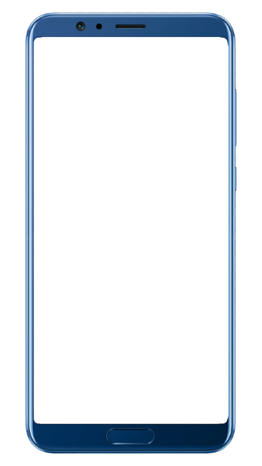
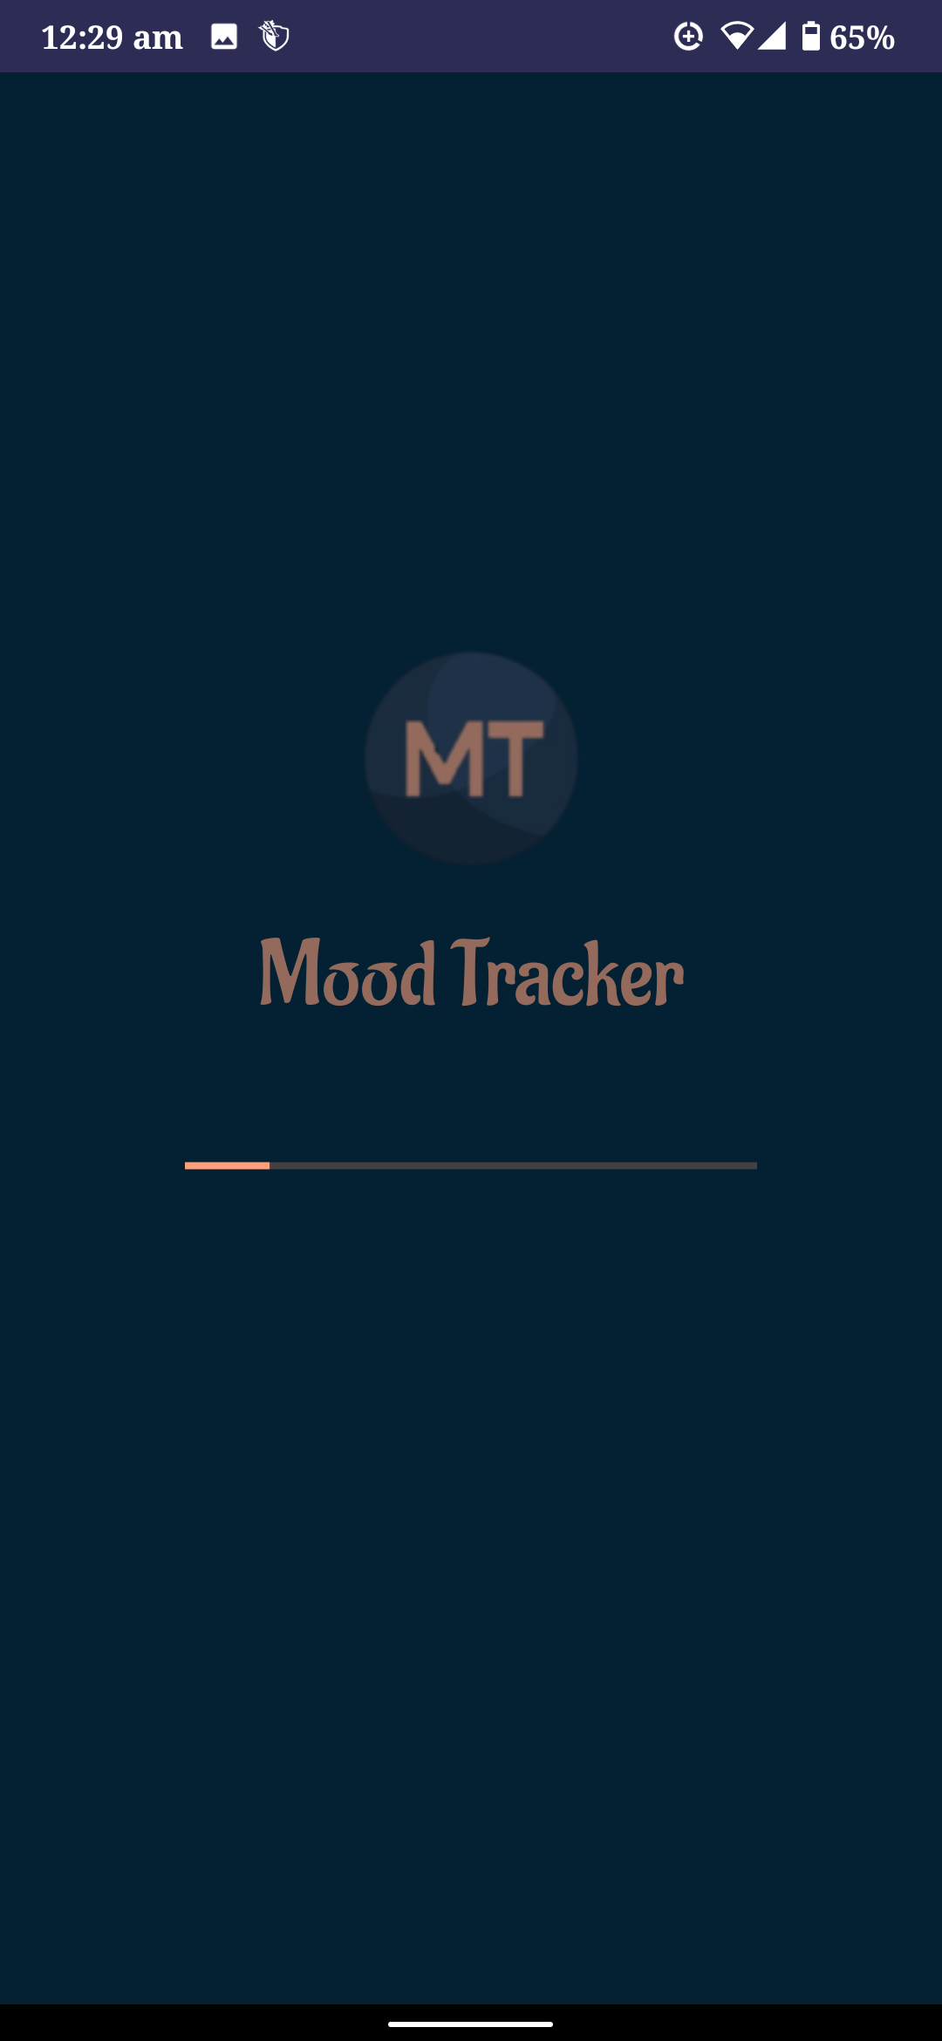
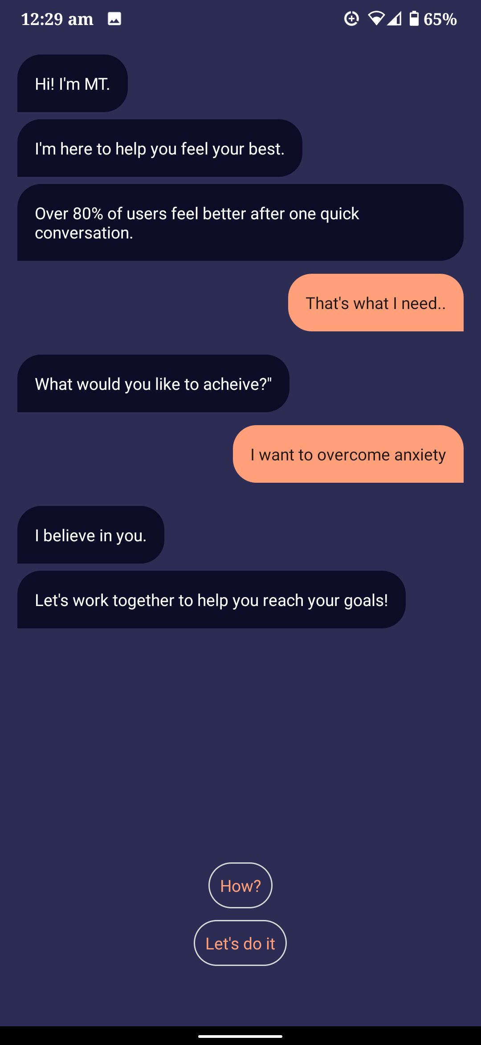
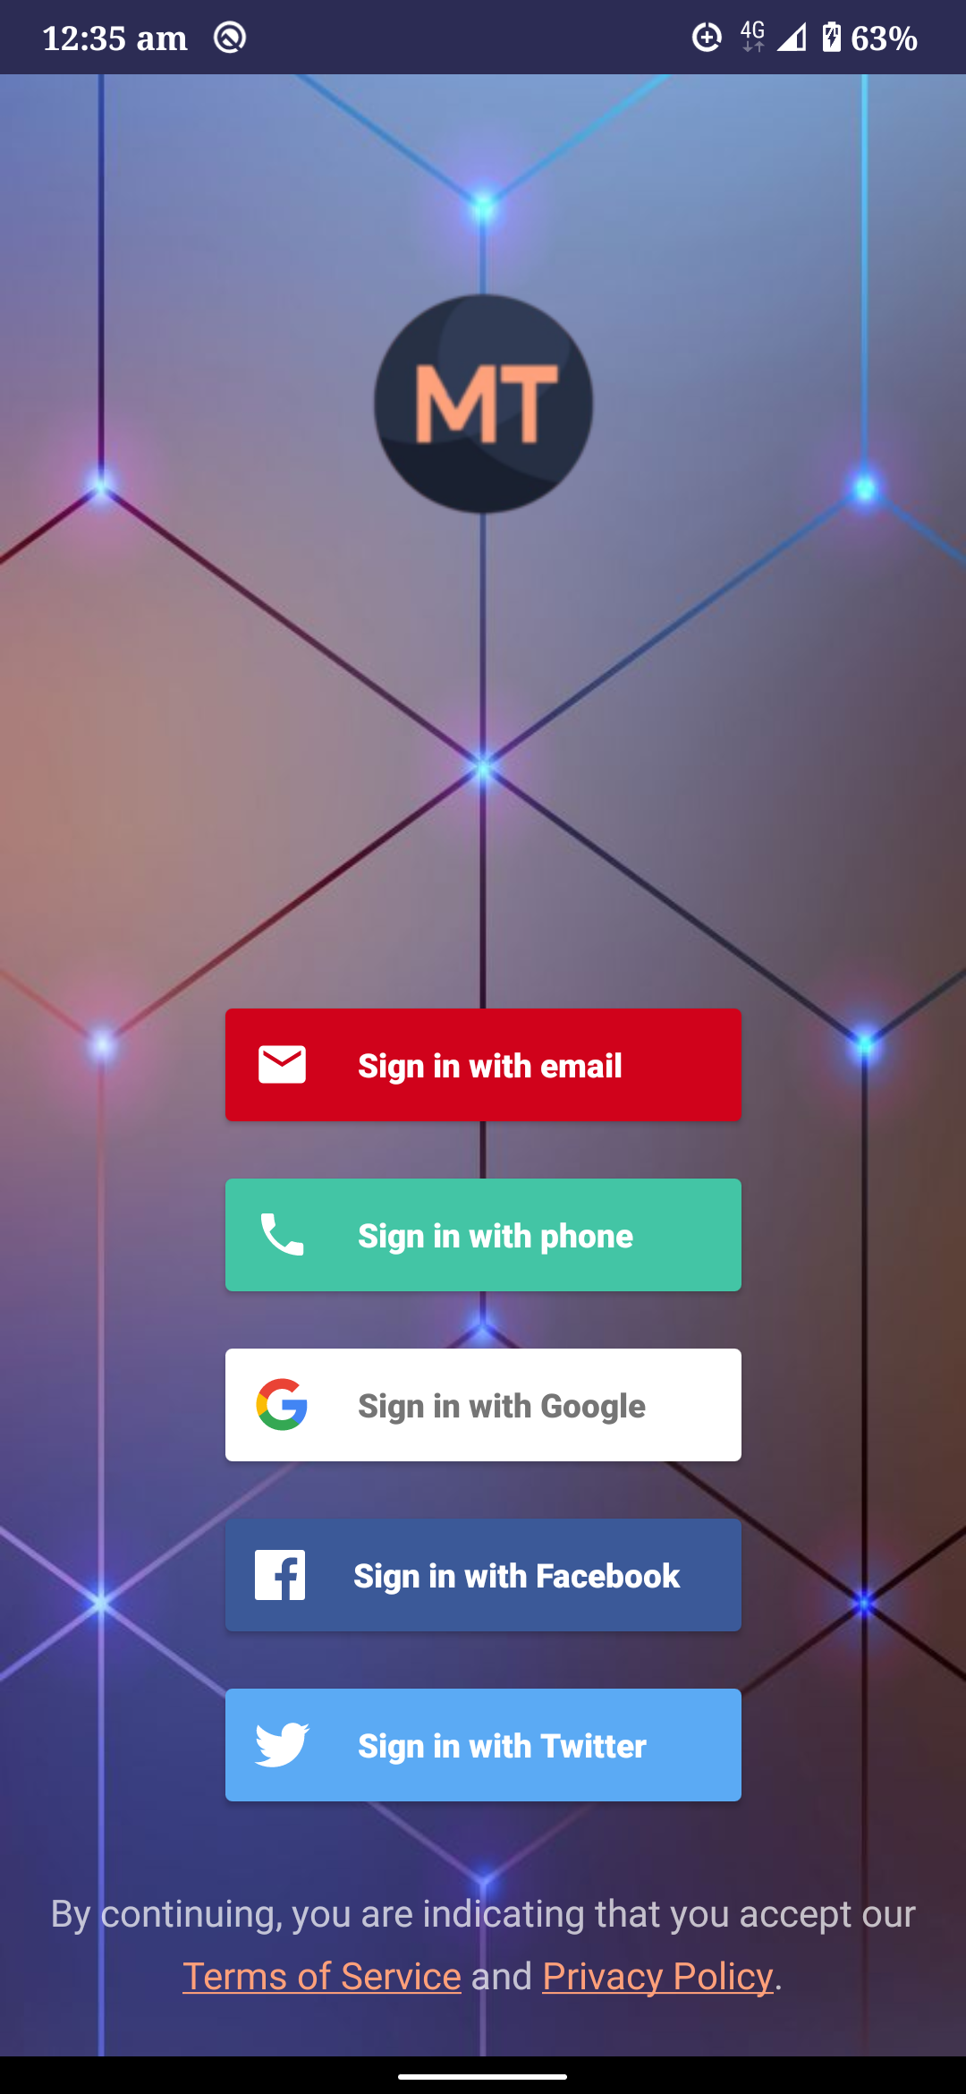
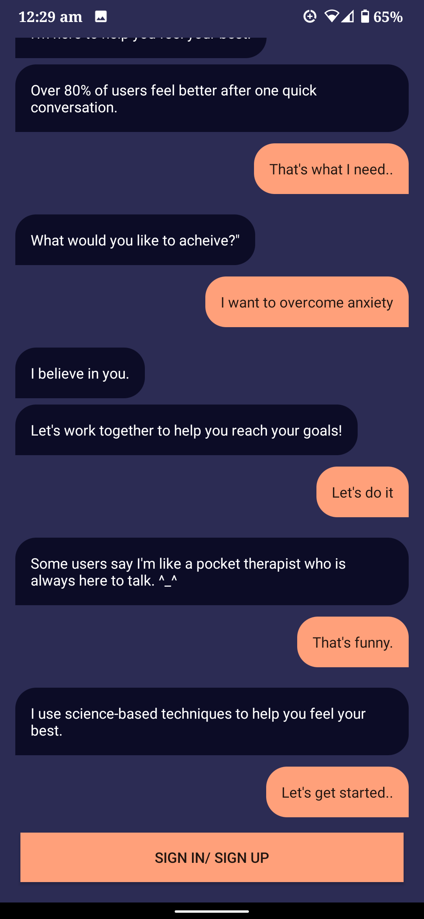
Welcome Conversation
SIGN IN/SIGN UP
with Twitter Account

Slide 28
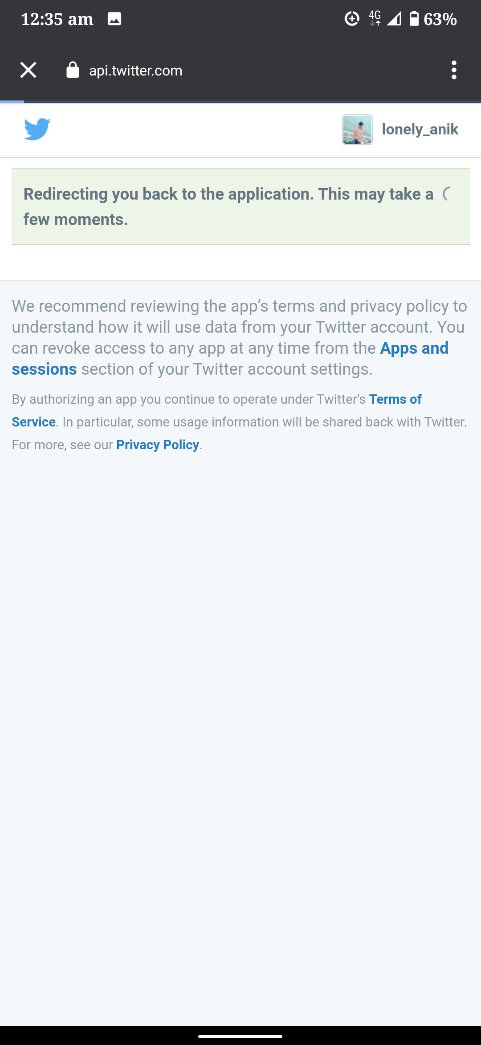
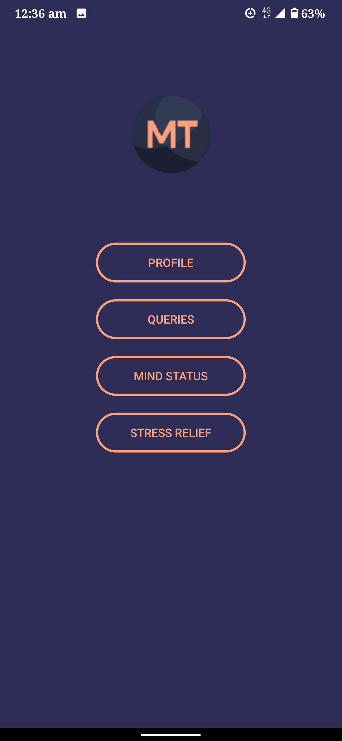
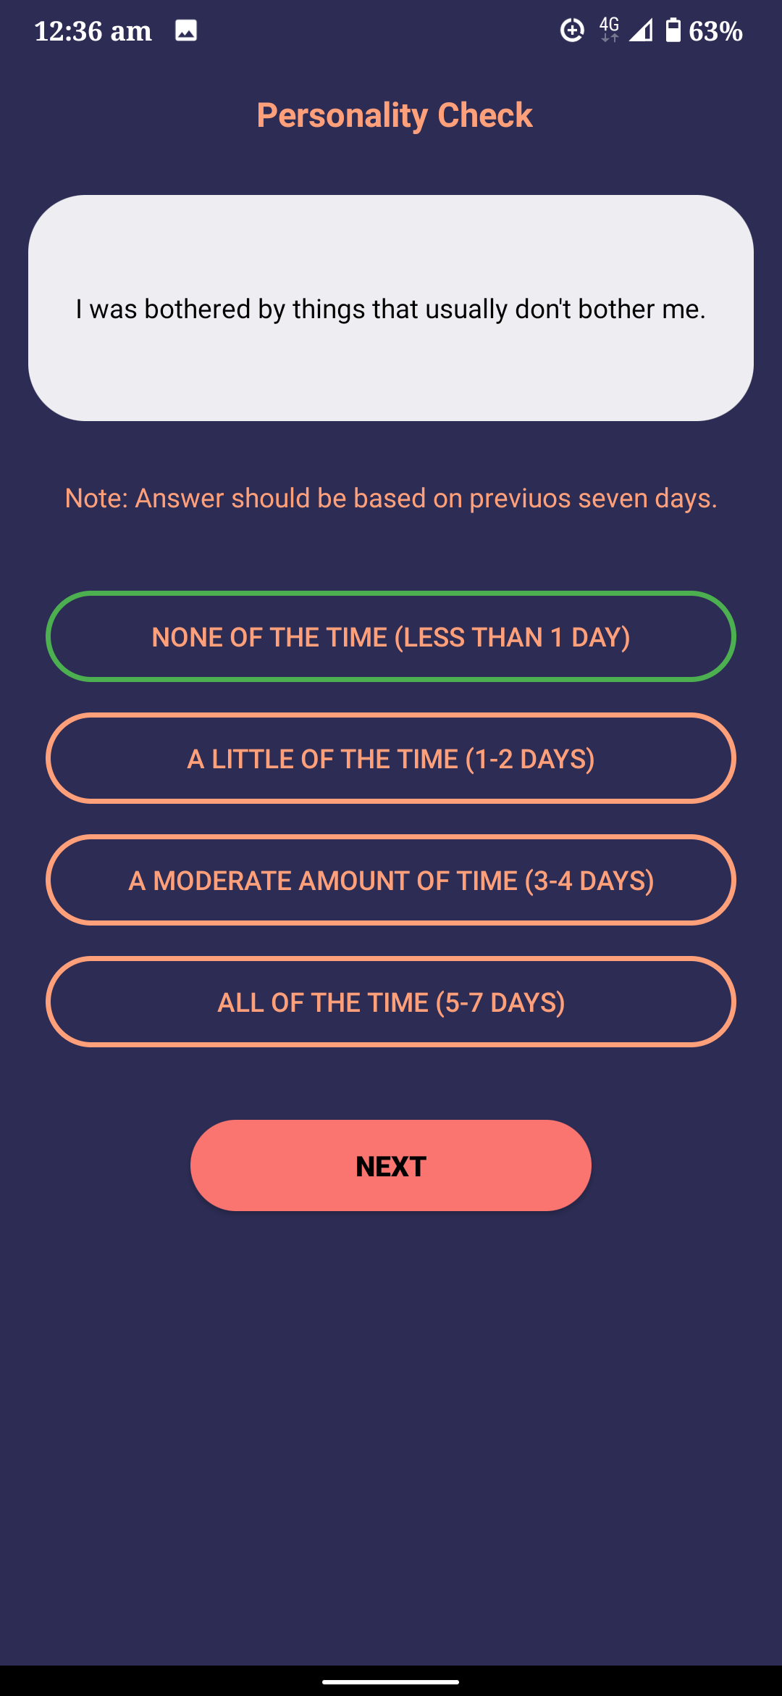
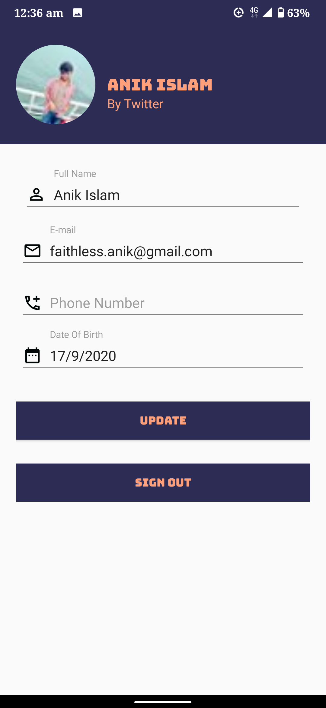
User Account
User Profile
Continue
Attempt queries

Slide 29
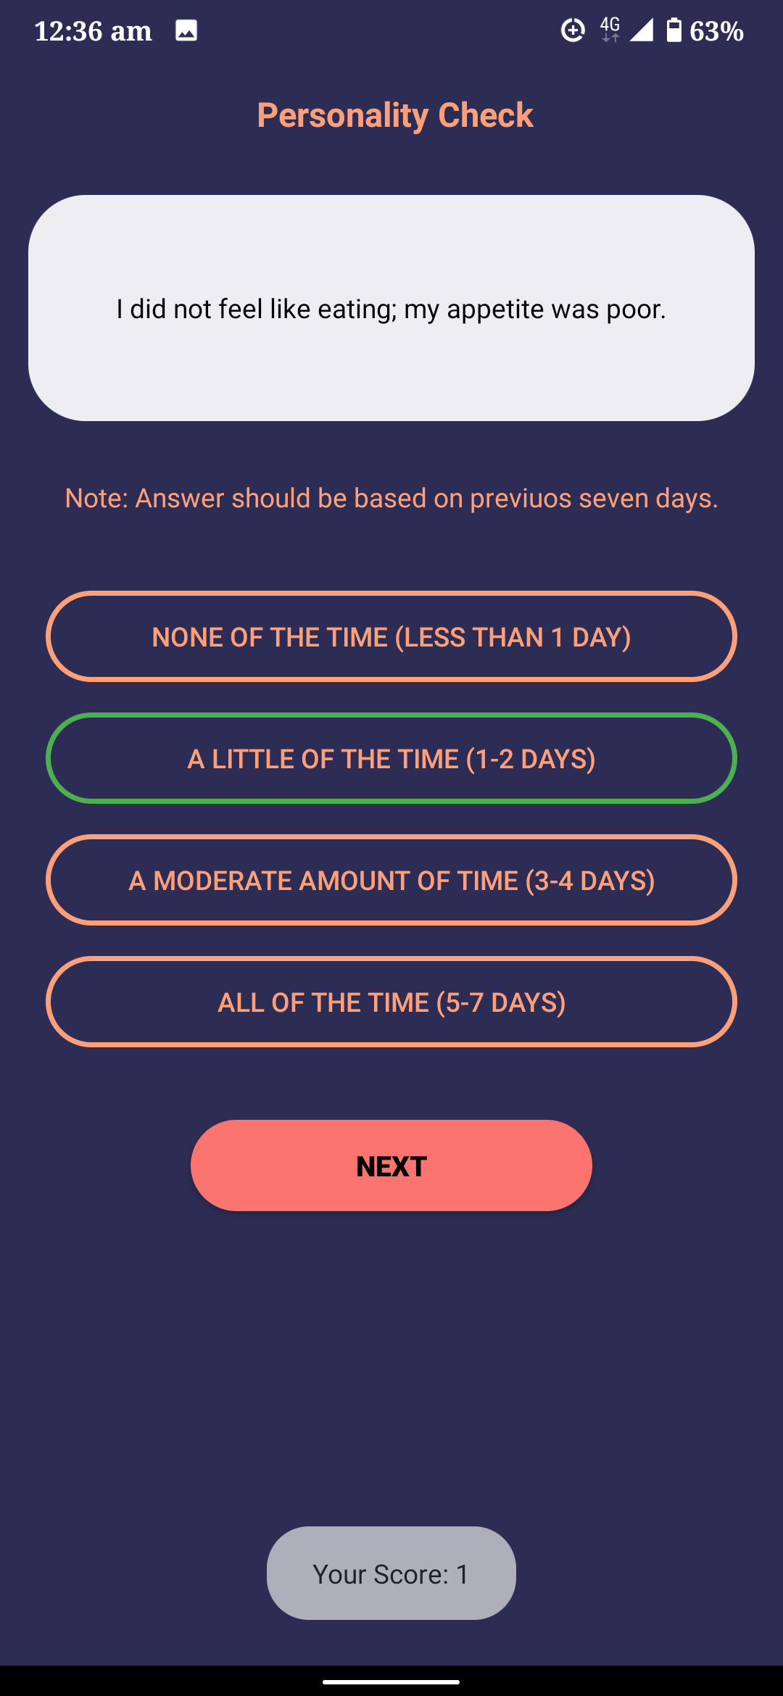
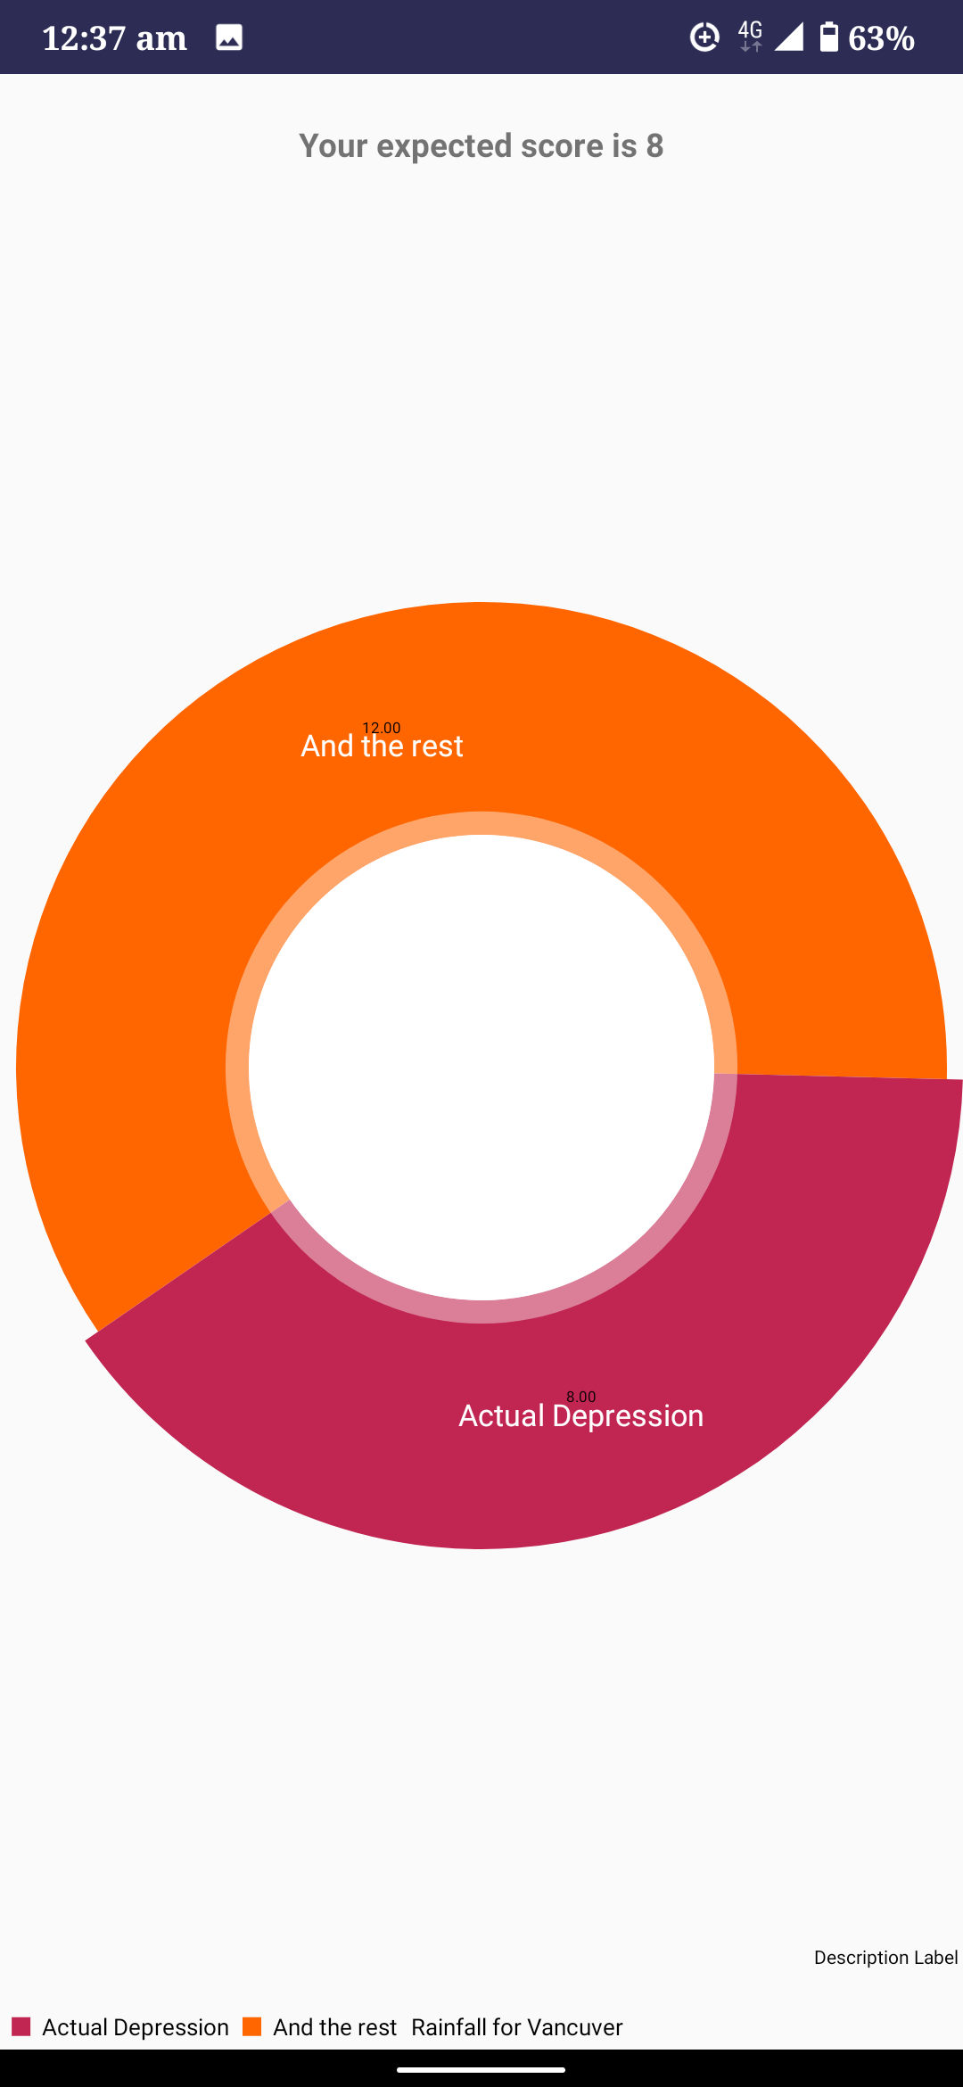

Predicted Result

Slide 30
Management

Slide 31

Standards
Software constraints
Android 4.2 ( Jelly Bean )
Hardware constraints
Mobile RAM: Minimum of 1 GB, 2 GB is recommended
Communication Standards
IEEE 802.11b
Programming languages
Python
Java
Data formats
CSV
Text

Slide 32

Design Constraints
Economic Constraint
Health and Safety Constraint
Social Constraint
Ethical Constraint
Manufacturability and Cost Analysis
Sustainability

Slide 33

Future work
Increasing accuracy
Classification of mental disorders
Binding our model into android platform
Analyzing with Bangla Phonetics

Slide 34

Conclusion
Our system will benefit the society of Bangladesh and encourage the citizen to
pay attention to their mental well being.
We are implementing this system in hope that is will reduce the rate of suicides
and self-destruction in Bangladesh
Hola

Slide 35


